Slide 1
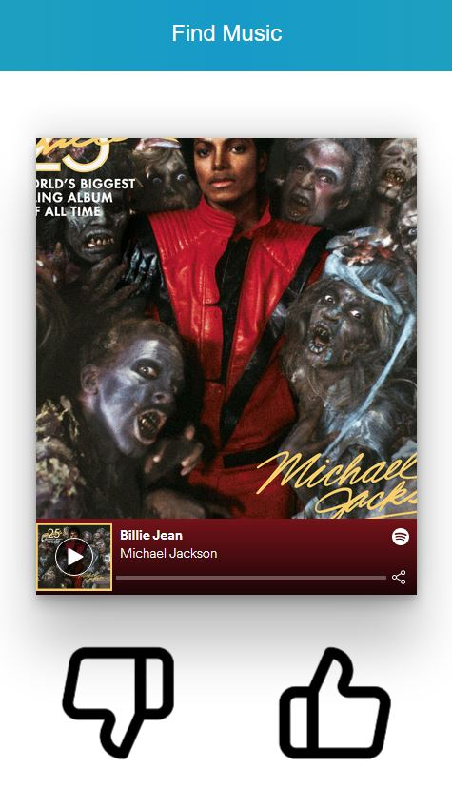
MyJams
CSC648-01 Team 3

Slide 2
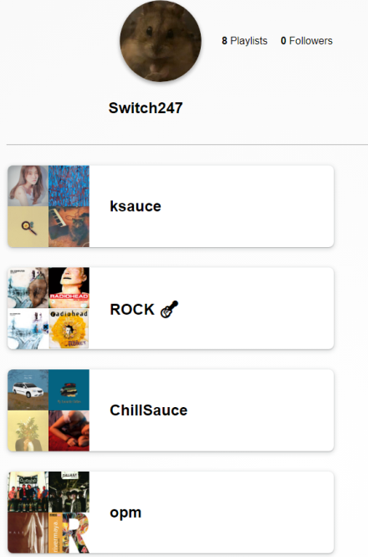
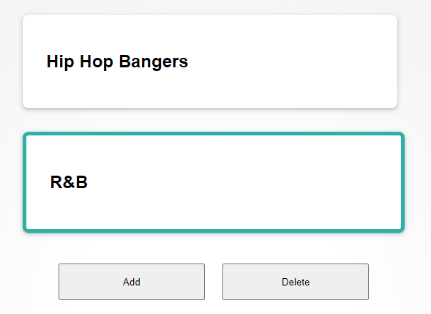

What is MyJams?
Login using a Spotify account via Spotify authorization.
Profile is generated containing user’s spotify playlists.
Create a preference based on:
Genre
Energy Level
Acousticness
Popularity
Uses Spotify api to get audio features.
Songs are recommended based on the selected preference.
Listen to the song demo, like or dislike the songs.
Preference is edited based on which songs are liked or disliked.
Future recommendations are more likely to contain songs with
similar audio features.
Notes:
Anthony - Our application is MyJams. MyJams is what we like to call Tinder, but for music.
Our app uses a Spotify Account and spotify authorization to log in. For each user a profile is generated containing a list of their recent playlists. And the main functionality of MyJams is to recommend music based on the user’s taste.
A user creates a preferences based on a genre, the energy level of a song, it’s acousticness, and popularity.
Then we use spotify’s api to get audio features of songs.
Songs are then recommended with similar audio features based on the user’s selected preference.
We can listen to each song, determine if we dislike or like them and in doing so, the preference is edited, so that future recommendations become more likely to contain songs that the user does like.

Slide 3



Our Targeted Clients
Cassandra Louis
33 year-old middle school teacher
Roberto Gonzales
27 year-old workaholic
Felix O’Connell
16 year-old high school student
Notes:
Stephen -
We envisioned that our product would work well with people over 13 years of age.
Music is a fairly common interest among people in general, so we believe that most people would probably have some interest in our application.
Some of the people that we envisioned are:
Felix O’Connell, someone who enjoys showing off his music tastes and playlists
Cassandra Louis, A person who is looking for songs that fall under a specific type of category,
Roberto Gonzales, someone who is trying to discover their musical preference.

Slide 4
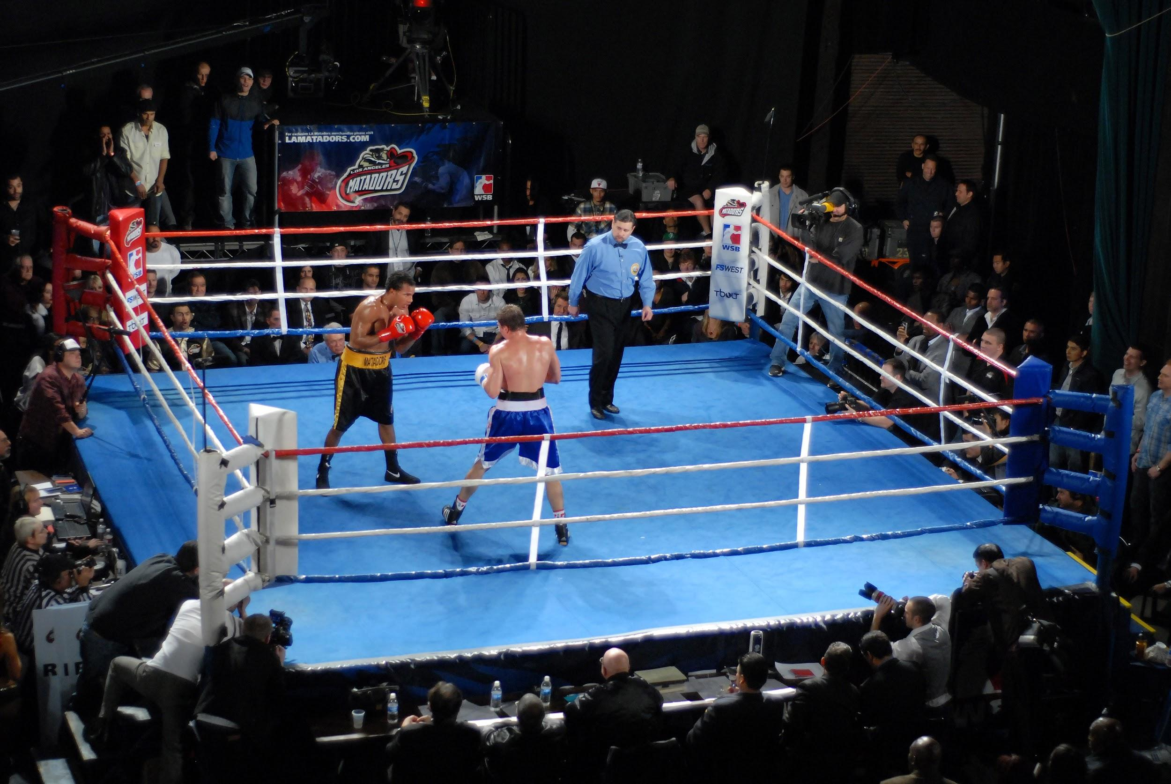
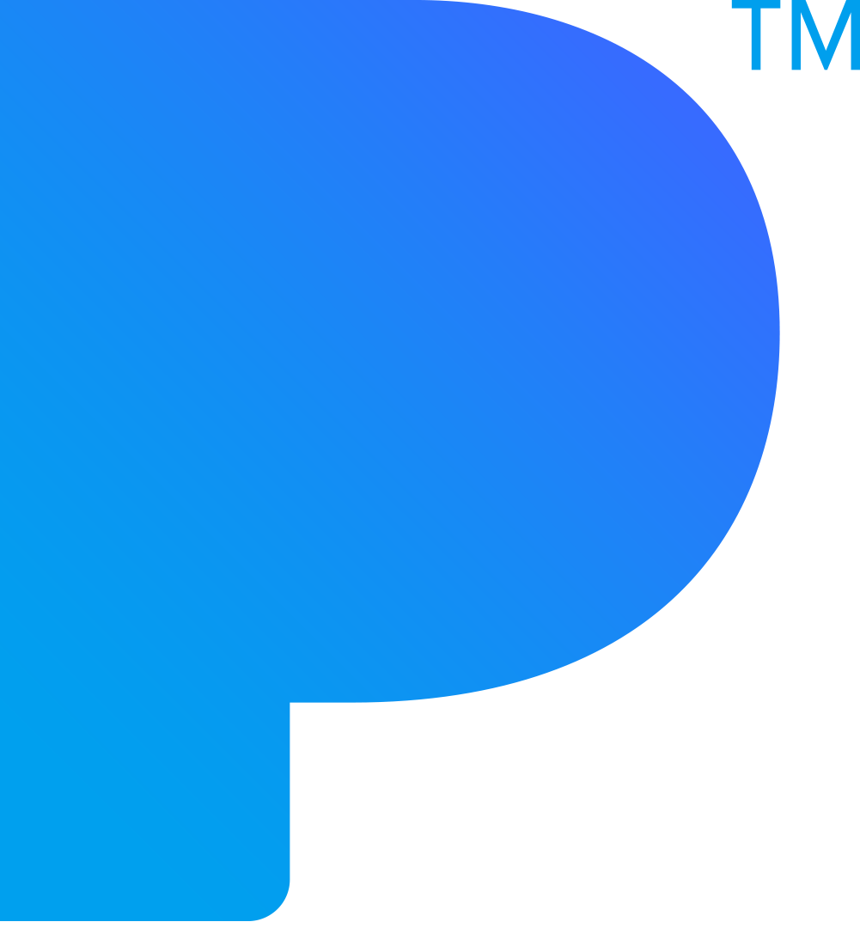

Competitive analysis
Uses more of spotify’s audio features
Onboarding survey
Focuses on more niche music
Spotify
Fast to find new music (you only have to listen to a short part of the song)
Pandora
Recommends based on what other people with similar tastes like
Able to add more specifications to recommendations

Slide 5
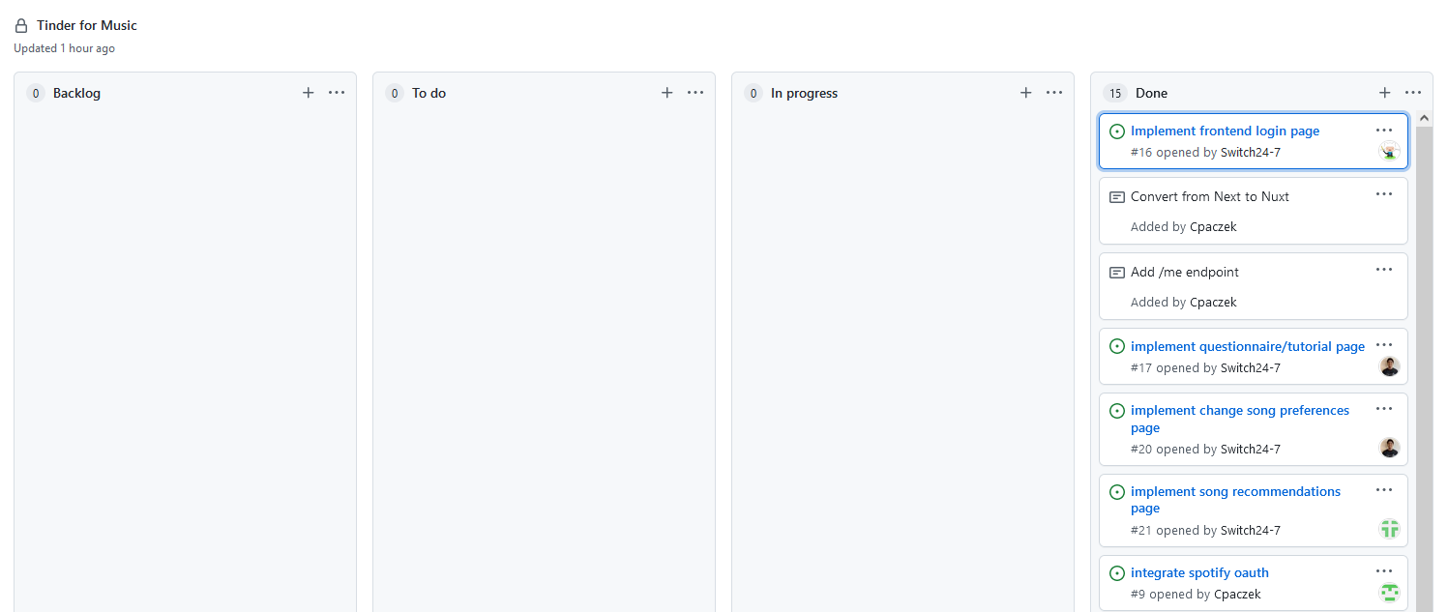
Team Building
Discord primary means of communication
Github Kanban Board
Weekly Meetings
Played Among Us and skribbl.io
Notes:
Nathan - Our team rarely had any problems throughout this project and communication was pretty much streamlined. We mainly used Discord as primary means of communication for everything from meeting minutes, writing notes, assigning items, etc. We also used Github’s project feature as a Kanban Board to further communicate with each other whose tasked with what and what their progress is. We also had weekly meetings to discuss progress and ask any clarifying questions when everyone was free which was almost always every Tuesday and of course another meeting after class on Thursdays. We also tried to have some team building games at least every other week where we played a game to bond together as a team.

Slide 6
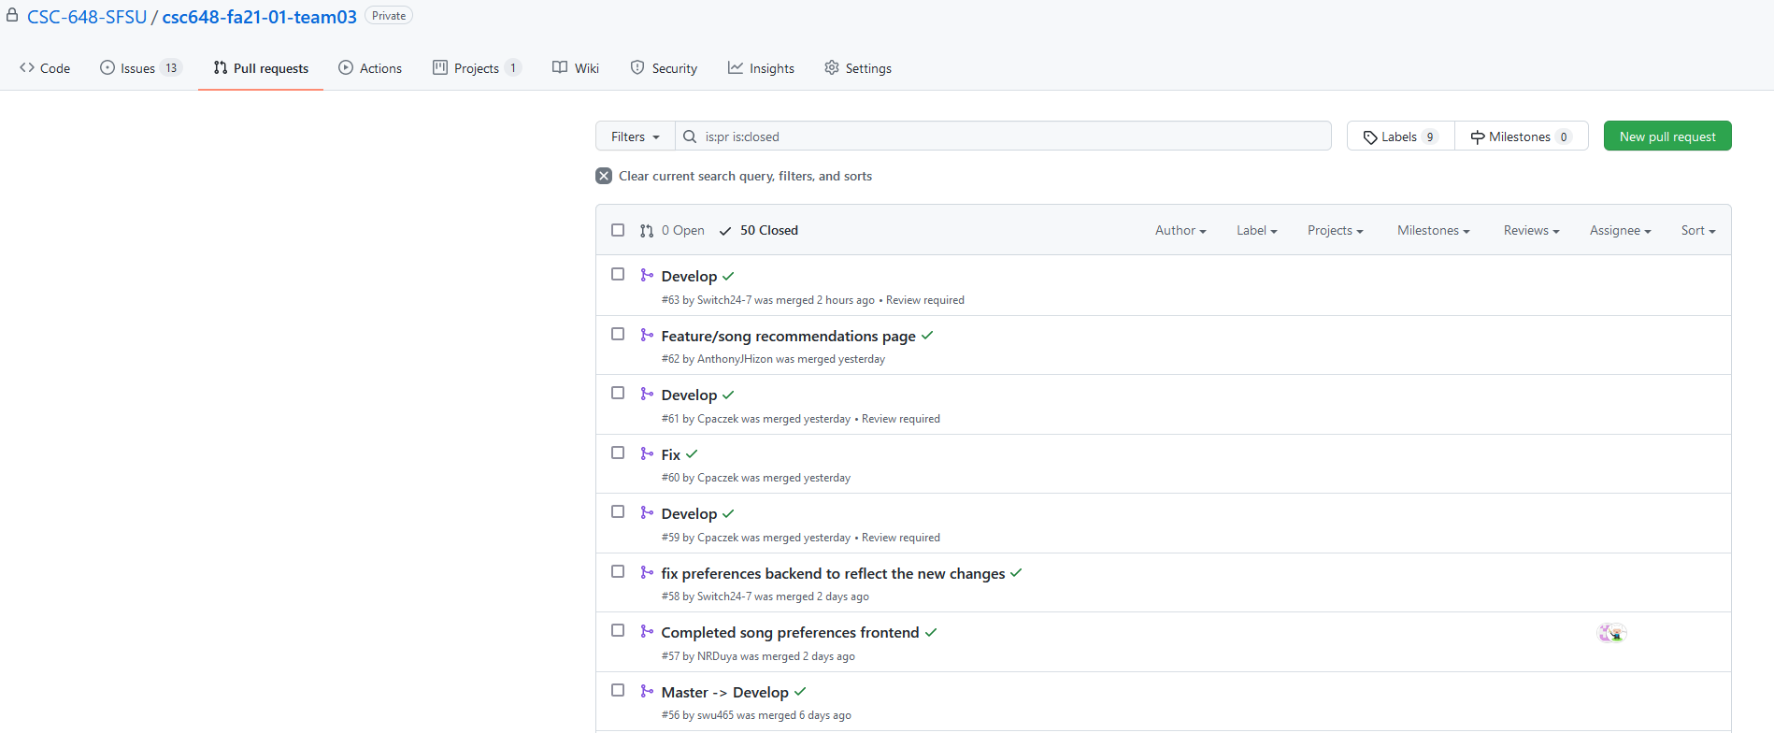
Code Review
Git pull requests
Peer coding
Notes:
Nathan - Our process for Code Reviews were fairly simple. First off, we had everyone implement each feature on separate branches. Once anyone finished implementing their feature, they would create a pull request on github which should be assigned to Simon, our Gitmaster, and Cameron, our team lead. They would then review whatever code/files were changed and then merge to develop once they finish. We would also merge everything from develop to master during meetings so that we can find any issues with any specific feature and either fix it together or have whoever made the feature fix it if it’s too much time. Some of our teammates also did peer coding where one person would “drive” and both would contribute ideas which would really help in catching errors and such.

Slide 7
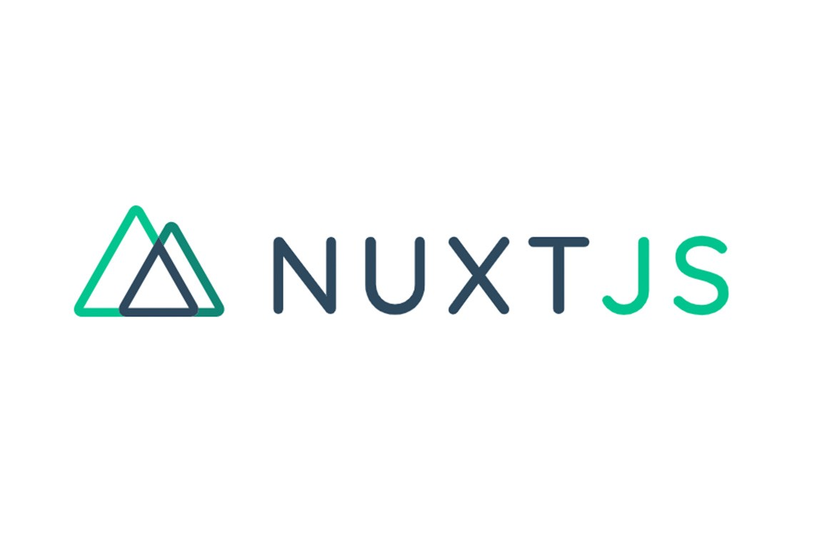


Our Stack
NuxtJS
Express
Mongo
Notes:
Cameron

Slide 8

Development
Feathers to Express
React (Next) to Vue (Nuxt)
More control over code, easier for us to understand
Lots of lost progress
Notes:
Dimitri:
Feathers to Express, restarting backend meant a lot of lost progress
However better long term, better understanding and control of code
Right around m3 we decided that we would switch our backend framework from feathersjs, a lightweight realtime enabled backend framework, to express, something that is more bare bones but more customizable and suitable to our needs. Obviously, as we had already completed some backend functionalities this was a a major set back however switching to express offered us key advantages over feathers:
First, because we were more familiar with express we were able to quickly recover the progress that we had previously made
this familiarity also allowed us to create code and structures that were more easily managed, bug fixed, and tested
There were no unknowns, the code is wholly our own and so we know exactly what things do what–which is to say with feathers there were many behind the scenes functions that we werent learned on which made it extremely difficult to bugfix or manage.
So overall, the switch was a good one.
Outside of the switch, development went relatively smoothly

